Slide 1


Data types in C++
Representing data in C++
Part 1 – Primitive data types

Slide 2

Primitive Data
Section 1

Slide 3

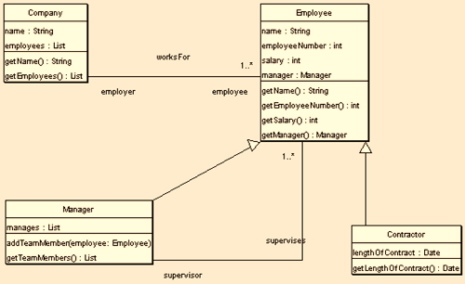
Fundamentally programs process data. Data can be classified as belonging to a specific type. A data type is defined as a set of valid values AND a set of operations that can be applied to these values.
C++ classifies data types as being primitive or class data types.
Primitive data types come with with predefined valid values and operations. Class data types are programmer defined.

Slide 4

C++ provides the following built-in primitive numerical data types
Integer Types
Floating-point Types
Numerical Data Types
Data Type | Common Operations
Integer | +, -, *, /, &, =, ==, !=, <=, >=, sizeof()
Floating-point | +, -, *, /, =, ==, !=, <=, >=, sizeof()
Notes:
C++’s built-in numerical data types consist of the basic numerical types shown

Slide 5
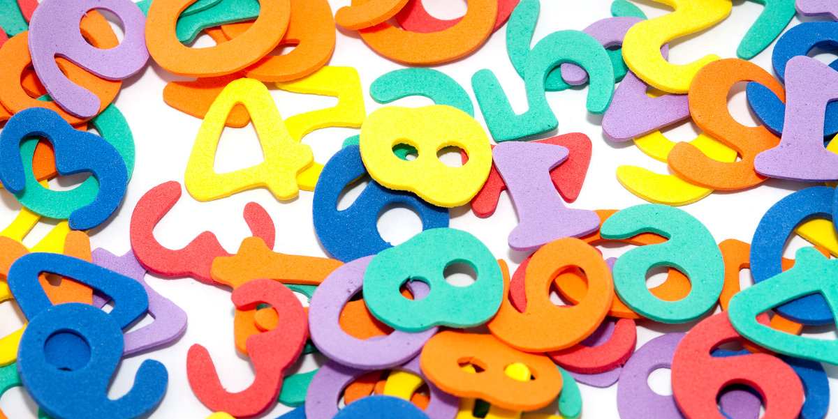
Integer Types

Slide 6
Integer Data Types
char
short int
int
long int
unsigned char
unsigned short int
unsigned int
unsigned long int
bool
C++ provides 9 built-in integer data types. The core difference between the data types is the amount of storage used for each type, which determines the range of values for each type.
The three most common types are int, char and bool.
The other six types provide more specialised storage. Either for storage of very large numbers or as a means of maximizing memory usage.

Slide 7
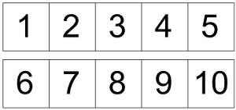


int data type values are whole numbers (without a decimal point). int’s typically occupy 4 bytes in memory (permitting values of -2,147,483,648 to 2,147,483,647).
char data type values are single characters (alphanumeric and other). Character values are typically stored using the ASCII or Unicode character sets.
bool data type values are the Boolean (logical) values of true and false.
Notes:
int data type
int data type values are whole numbers (integers). An integer value can be the number 0 or any positive or negative number without a decimal point.
Typically 4 bytes are used to store an int representing integers from -2,147,483,648 to 2,147,483,647.
char data type
char data type values are single characters (alphanumeric and other). Character values are typically store using the ASCII or Unicode character sets.
The newer Unicode code is used for international applications because it accommodates
character sets for almost all languages, in addition to English. As the first 256 Unicode codes are the same binary codes as the complete set of 256 ASCII codes.
bool data type
bool data types values are the Boolean (logical) values of true and false.

Slide 8

Determining Storage Size
The sizeof()operator enables the number of bytes used to store the specified data to be determined (works on primitive data, structs, etc.).
sizeof() can be equally applied to a given variable or a type name. Note, parentheses must be used for type names but are optional for named variables.
1 | std::cout << "int is " << sizeof (int) << " bytes. ";
2 | std::cout << "int is " << sizeof someInt << " bytes. ";
Notes:
Determining Storage Size
The sizeof()operator enables the number of bytes used to store the specified data to be determined (works on primitives data, structs, etc.).
cout << "int is " << sizeof (int) << " bytes. ";
cout << "char is " << sizeof someCharVar << " bytes. ";
The sizeof() operator can be applied to a given variable or a type name. When used with a type name, the type must be enclosed in parentheses. They are optional for named variables (but recommended).

Slide 9
Determining Storage Size
The climits header file contains a number of constant definitions for the largest and smallest values that can fit within each defined type (the values are system and compiler dependent). Selected values for Visual Studio are:
Data Type | Max storable integer
Maximum signed char value | 127
Maximum unsigned char value | 255
Maximum short value | 32767
Maximum unsigned short value | 65535
Maximum int value | 2147483647
Maximum unsigned int value | 4294967295
Maximum long value | 2147483647
Maximum long long value | 9223372036854775807
Notes:
climits Header File
The climits header file contains a number of constant definitions for the largest and smallest value that can fit within each defined type (the values are system and compiler dependent).
Selected values for the Visual Studio provided climits file are:
Symbolic Constant Represents
SCHAR_MAX Maximum signed char value 127
SCHAR_MIN Minimum signed char value 0
UCHAR_MAX Maximum unsigned char value 255
SHRT_MAX Maximum short value 32767
SHRT_MIN Minimum short value -32768
USHRT_MAX Maximum unsigned short value 65535
INT_MAX Maximum int value 2147483647
INT_MIN Minimum int value -2147483648
UINT_MAX Maximum unsigned int value 4294967295
LONG_MAX Maximum long value 2147483647
LONG_MIN Minimum long value -2147483648
LLONG_MAX Maximum long long value 9223372036854775807
LLONG_MIN Minimum long long value -9223372036854775808

Slide 10
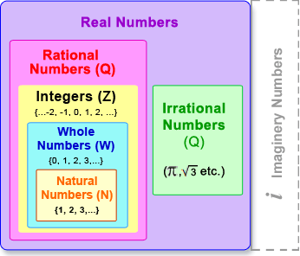
Signed and UnSigned
A signed data type can store both negative and positive values. An unsigned data type can only store non-negative values (0 and above).
Unsigned integer types, such as unsigned int, provide a range of positive values that are effectively double the range of their signed variants. This extra positive range is made available by using the negative range of the signed version for extra positive numbers.
Notes:
A signed data type can store both negative and positive values. An unsigned data type can only store non-negative values (0 and above).
Unsigned integer types, such as unsigned int, provide a range of positive values that are effectively double the range of their signed variants. This extra positive range is made available by using the negative range of its signed version for additional positive numbers.
Signed vs unsigned is less relevant today than previously where memory were very much more limited and data types were represented using fewer bytes.
In early systems, an int typically used 2 bytes of storage. Limiting the storage range to -32,768 to +32,767 with an unsigned int ranging from 0 to 65,535. This often made a difference. With current int values using 4 bytes increased a maximum value of about 2 billion (4 byte int) to about 4 billion (4 byte unsigned int) is less useful.

Slide 11
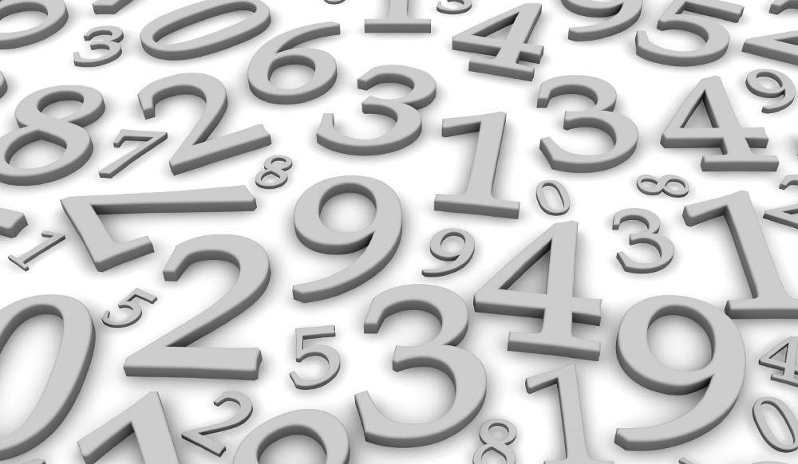
Floating Point Types

Slide 12
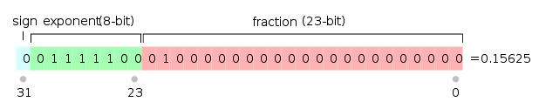
Floating-point numbers comprise 0.0 and any other number containing a decimal point (e.g. -4.0 is a floating point number).
Floating-point Data Types
float
double
long double
C++ offers float, double, and long double which differ in the amount of memory used.
A double typically uses twice the memory of a float. The terms single-precision and double-precision are sometimes used.
Notes:
Floating-point numbers (mathematically real numbers), are the number 0.0 and any other positive or negative number containing a decimal point (e.g. 3.5 or 4.0). Note: 2 is an integer, 2.0 is a floating point number
C++ has three floating-point data types: float, double, and long double. They differ in terms of the amount of memory used to store each type.
It is common for a double to use twice as much memory as a float (i.e. offering twice the precision). Hence, a float is termed a single-precision number and a double-precision number.

Slide 13
Most C++ compilers allocate 4 bytes for float and 8 bytes for double and long double.
A float literal is indicated by appending an f or F to the number, and a long double is created by appending an l or L to the number. Without any suffix, a floating-point number defaults to a double.
Data Type | Maximum and Maximum
float | 1.40129846432481707x10⁻⁴⁵ to 3.40282346638528860x10³⁸
double and long double | 4.94065645841246544x10⁻³²⁴ to 1.79769313486231570x10³⁰⁸
Data Type | Example
float literal | 3.14f / 3.14F
double literal | 3.14
long double literal | 3.14l / 3.14L
Notes:
Most C++ compilers allocate 4 bytes for floats and 8 bytes for doubles and long double.
A float literal is indicated by appending an f or F to the number, and a long double is created by appending an l or L to the number. Without any suffix, a floating-point number defaults to a double.

Slide 14

Key takeaways:
C++ possesses a good number of different primitive data types.
Only a small subset of available types are commonly used.
Other types have become less relevant over the years or have specialised uses.

